Slide 1
Java GUI
Swing Programming

Slide 2
GUI
Windowing systems that interact with the user are often called GUIs.
GUI is pronounced “gooey” and stands for graphical user interface .

Slide 3
Events and Listeners
Swing GUIs are designed using a particular form of object-oriented programming that is known as event-driven programming.

Slide 4
Events and Listeners
Swing programs use events and event handlers.
An event is an object that acts as a signal to another object known as a listener .
The sending of the event is called firing the event .
The object that fires the event is often a GUI component, such as a button.

Slide 5
Events and Listeners
The button fires the event in response to being clicked.
The listener object performs some action in response to the event.
For example, the listener might place a message on the screen in response to a particular button being clicked.

Slide 6
Events and Listeners
A listener object has methods that specify what will happen when events of various kinds are received by the listener.
These methods that handle events are called event handlers .
You the programmer will define (or redefine) these event-handler methods.

Slide 7
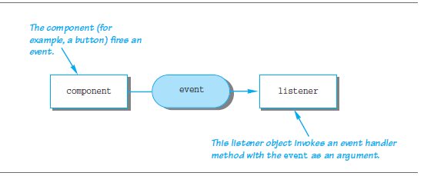
Events and Listeners

Slide 8
GUI Components
JFrame
Button
Label
Color

Slide 9
JFrame
A JFrame object is a basic window that includes a border and the usual three buttons for minimizing the window down to an icon, changing the size of the window, and closing the window.

Slide 10
See article 17.3 (AbsoluteJava) for functions of Jframe Class

Slide 11
Buttons
A button object is created in the same way that any other object is created, but you use the class Jbutton
  JButton endButton = new JButton ("Click to end program.");
  firstWindow.add(endButton);

Slide 12
Simple GUI
import javax.swing.*; import java.awt.*;
class SimpleGUI extends JFrame{
SimpleGUI(){
setSize(400,400); //set frames size in pixels
setDefaultCloseOperation(EXIT_ON_CLOSE);
setVisible(true);
JButton button1 = new JButton(“Click me”);
MyActionListener a = new MyActionListener();
button1 .addActionListener(a));
add(button1 );
}
}

Slide 13
Event Handler Code
class MyActionListener implements ActionListener{
public void actionPerformed(ActionEvent ae){
JOptionPane.showMessageDialog(new JFrame(), “I got clicked”);
}
}

Slide 14
Runner
class GUIRunner
{
public void main(String arg[])
{
SimpleGUI sg = new SimpleGUI()
}
}

Slide 15
Action Listeners and Action Events
A button’s action is programmed by registering a listener with the button using the method addActionListener.
  JButton niceButton = new JButton("Click here");
  niceButton.addActionListener(new SomeActionListenerClass());

Slide 16
Action Listeners and Action Events
Clicking a button with your mouse (or activating certain other items in a GUI) creates an object known as an event and sends the event object to another object (or objects) known as the listener(s).
This is called firing the event .
The listener then performs some action.

Slide 17
Action Listeners and Action Events
When we say that the event is “sent” to the listener object, what we really mean is that some method in the listener object is invoked with the event object as the argument.
This invocation happens automatically

Slide 18
Action Listeners and Action Events
First, for each button, it needs to specify what objects are listeners that will respond to events fired by that button; this is called registering the listener.
Second, it must define the methods that will be invoked when the event is sent to the listener.

Slide 19
Action Listeners and Action Events
Note that these methods will be defined by you, but in normal circumstances, you will never write an invocation of these methods.
The invocations will take place automatically.
  EndingListener buttonEar = new EndingListener( );
  endButton.addActionListener(buttonEar);

Slide 20
Action Listeners and Action Events
Different kinds of components require different kinds of listener classes to handle the events they fire.
A button fires events known as action events , which are handled by listeners known as action listeners

Slide 21
Action Listeners and Action Events
An action listener is an object whose class implements the ActionListener interface.
The ActionListener interface has only one method heading that must be implemented, namely the following:
  public void actionPerformed(ActionEvent e)

Slide 22
Another GUI Program
class SimpleGUI extends JFrame{
SimpleGUI(){
/* .... */
setLayout(new GridLayout() );
JButton button1 = new JButton(“Click me”);
JButton button2= new JButton(“exit”);
MyActionListener al = new MyActionListener();
button1 .addActionListener(al);
button2 .addActionListener(al);
add(button1 );
add(button2);
}
}

Slide 23
How to distinguish events –Less good way
class MyActionListener implents ActionListener{
public void actionPerformed(ActionEvent ae){
if (ae.getActionCommand().equals(“Exit”){
System.exit(1);
}
else if (ae.getActionCommand().equals(“Click me”){
JOptionPane.showMessageDialog(null, “I’m clicked”);
}
}

Slide 24
Labels
label is an object of the class JLabel .
The text for the label is given as an argument to the JLabel constructor as follows:
  JLabel greeting = new JLabel("Hello");

Slide 25
Color
You can set the color of a JFrame (or other GUI object).
To set the background color
of a JFrame , use
  getContentPane().setBackground(Color.BLUE);

Slide 26
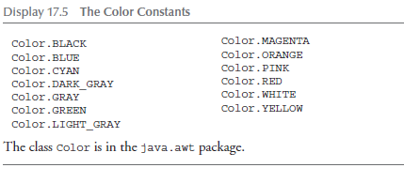
Color
To set the color of some component in a JFrame , such as a button, simply use the method setBackground with the button or other component as the calling object

Slide 27
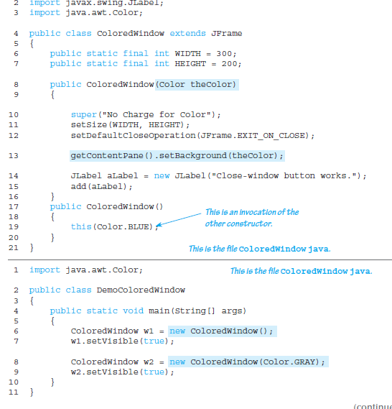

Slide 28
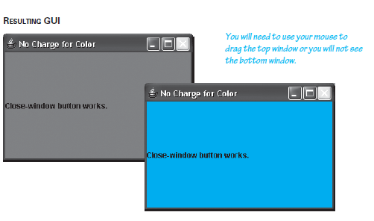

Slide 29
Containers and Layout Managers
the add method simply tells which components are added to the JFrame
it does not say how they are arranged, such as side by side or one above the other.
To describe how the components are arranged, you need to use a layout manager

Slide 30
Border Layout Managers
If you do not specify a layout, then Java will use a BorderLayout by default.
The components are arranged one below the other
A layout manager is added to the JFrame class with the following line:
  setLayout(new BorderLayout());

Slide 31
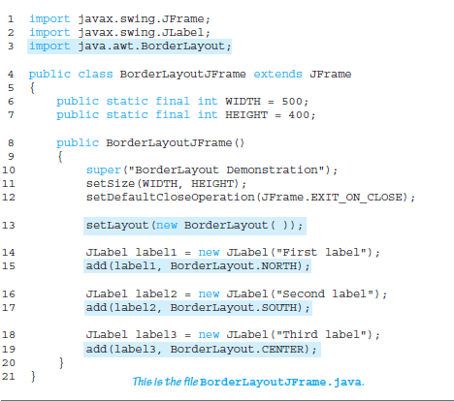
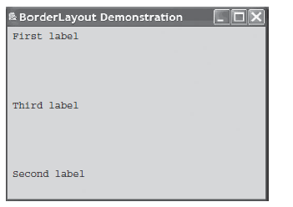

Slide 32
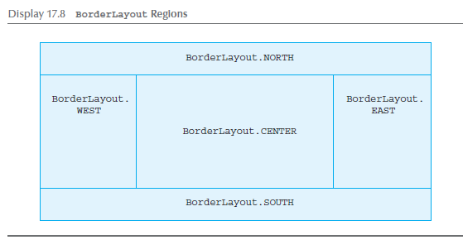
Border Layout Managers
The space is divided between regions as follows:
Regions are allocated space in the order first north and south, second east and west, and last center.
So, in particular, if there is nothing in the north region, then the east and west regions will extend to the top of the space.)

Slide 33
Flow Layout Managers
The FlowLayout manager is the simplest layout manager.
It arranges components one after the other, going from left to right, in the order in which you add them to the JFrame using the method add.

Slide 34
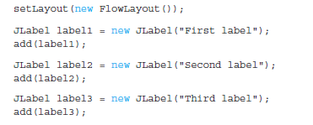
Flow Layout Managers

Slide 35

Grid Layout Managers
A GridLayout manager arranges components in a two-dimensional grid with some number of rows and columns.
With a GridLayout manager, each entry is the same size.
  setLayout(new GridLayout(2, 3));

Slide 36
When using the GridLayout class, the method add has only one argument.
The items are placed in the grid from left to right, first filling the top row, then the second row, and so forth.
You are not allowed to skip any grid position

Slide 37
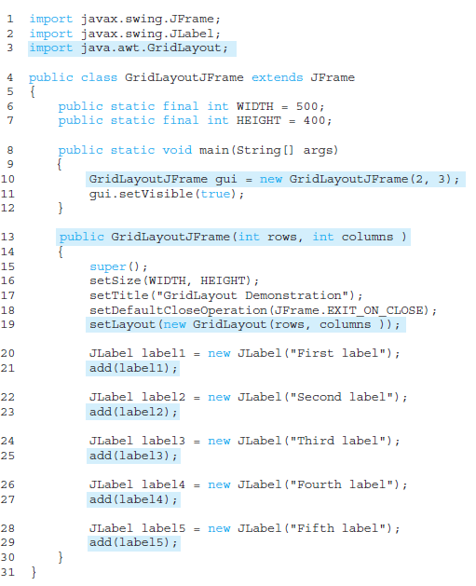

Slide 38
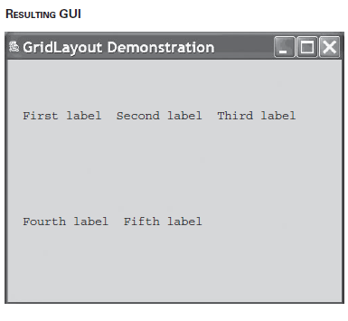

Slide 39
Panels
A panel is an object of the class JPanel , which is a very simple container class that does little more than group objects.
It is one of the simplest container classes, but an extremely useful one.
It groups smaller objects, such as buttons and labels, into a larger component (the JPanel )

Slide 40
You can then put the JPanel object in a JFrame .
Thus, one of the main functions of JPanel objects is to subdivide a JFrame (or other container) into different areas.

Slide 41
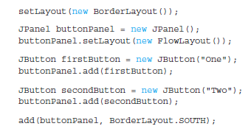

Slide 42

END

